Slide 1
Full Stack Application Development
Application Development- Introduction
Web application architectures
Monolithic and Microservices
Akshaya Ganesan

Slide 2
Monolithic Architecture
Microservices Architecture

Slide 3
Monolithic Application
The application is deployed as a single monolithic application.
For example, a Java web application consists of a single WAR file that runs on a web container such as Tomcat.
Difficulty to scale.
Redeployment of the entire application in case of change.

Slide 4
Service Oriented Architecture
Service-oriented architecture (SOA) is a business-centric IT architectural approach that supports integrating your business as linked, repeatable business tasks or services.
SOA exposes business functionalities as services to be consumed by applications.
Services are
loosely coupled
Autonomous
Robert C. Martin’s Single Responsibility Principle.
Gather together the things that change for the same reasons. Separate those things that change for different reasons.

Slide 5
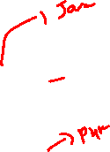
SOA Based Web Application
Client(Browser)
ESB
Web Service 1
Internet
Client(Browser)
Web Server
Web Service 2
Web Service N
CSS
Client(Browser)
HTML
JS
DB

Slide 6
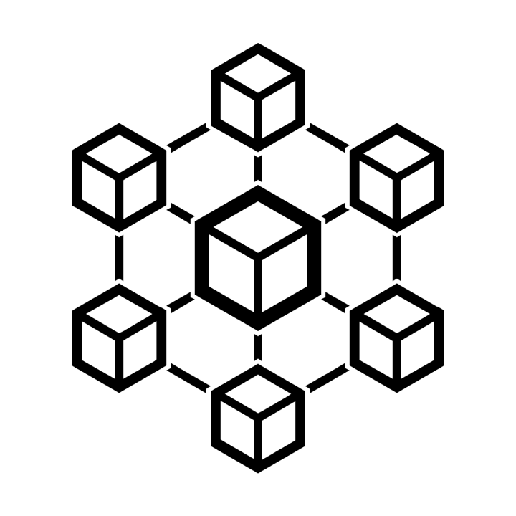
Microservice Architecture
Microservice Application
Is composed of many small, independent services.
Each service implements a single business capability.
Are loosely coupled, communicating through API contracts.
Can be built by a small, focused development team.

Slide 7
Microservice Architecture
More complex to build and manage
Requires a mature development and DevOps culture
Can lead to higher release velocity, and a more resilient architecture

Slide 8
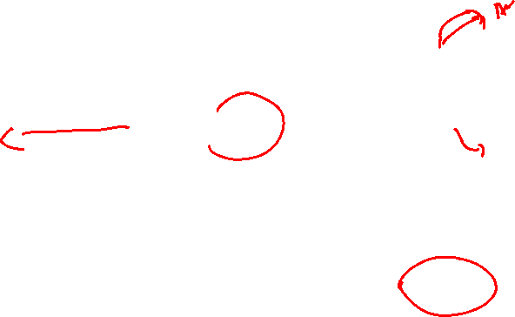
Microservices Application
Client
(Browser)
API Gateway
Web Service 1
DB
JSON
Web Service 2
DB
Web Service N
DB
CDN
Web Server
Static Content

Slide 9
Monolithic Architecture
Microservices Architecture

Slide 10
Thank You!

